Slide 1
Report on
Exploratory Data Analysis
for Data Science Apprenticeship CHALLENGE [Pathao Nepal 2024 Fall]

Slide 2
Summary of the data preparation process
Step-1 Query writing and exporting in .CSV file
Step-2 Loading Data and dropping unwanted columns
Step-3 Finding the missing values and handling them
Step-4 Handling the outliers of column served time, turn around time, waiting time by calculating IQR

Slide 3
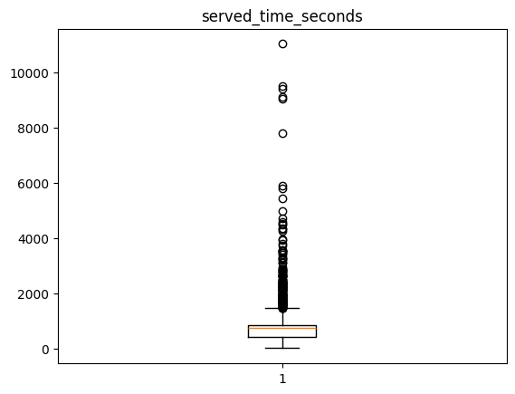
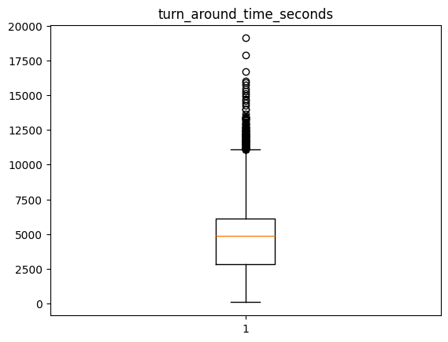
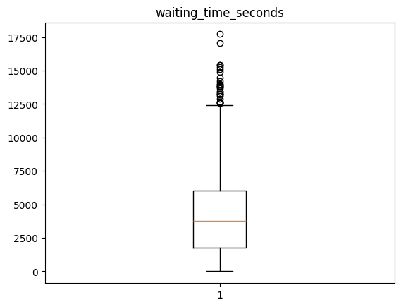
Outliers
184 outliers
109 outliers
27 outliers

Slide 4
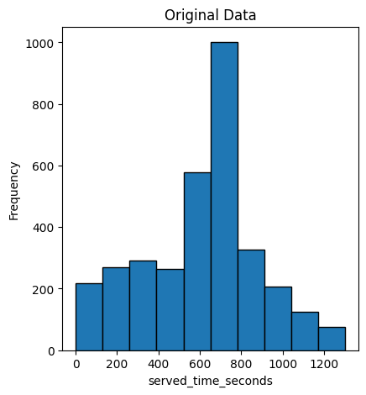
Key descriptive statistics
Descriptive Statistic of Served time:
Mean value : 629.3457317586203
Median : 698.0
Standard Deviation : 301.9465105885816
First Quartile: 413.25
Third quartile: 768.0
Minimum value : 1.0
Maximum value : 1462.0
Served times range from 1 second to 1462 seconds.
The data exhibits a moderate level of variability.
The median is higher than the mean, suggesting that there may be a right-skewed distribution, with a tail of longer served times as we can see in figure.

Slide 5
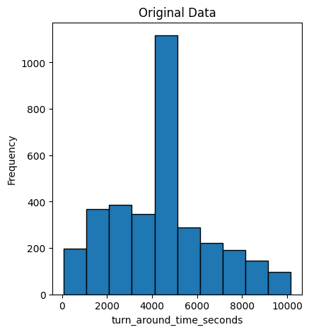
Key descriptive statistics
Descriptive Statistic of Turnaround time:
Mean value : 4614.6170664742085
Median : 4872.068688344903
Standard Deviation : 2372.1517069474867
First Quartile: 2813.25
Third quartile: 5752.0
Minimum value : 91.0
Maximum value : 11081.0
Turnaround time has a wide range varying from 91 seconds to 11081 seconds.
There is substantial variability in turnaround times, as shown by the large standard deviation.
The median is slightly higher than the mean, suggesting that the distribution is slightly right-skewed (more high values than low values).

Slide 6
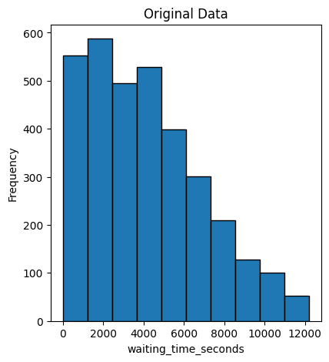
Key descriptive statistics
Descriptive Statistic of waiting time:
Mean value : 4128.746618575293
Median : 3762.5
Standard Deviation : 2819.736972999102
First Quartile: 1771.25
Third quartile: 5942.0
Minimum value : 0.0
Maximum value : 12415.0
The dataset ranges from 0 seconds to 12415 seconds, showing a wide span of values.
The data has significant variability, as indicated by the large standard deviation.
The mean is higher than the median, suggesting a right-skewed distribution, with a tail of higher values.

Slide 7
Key descriptive statistics
Descriptive Statistic of waiting time:
Mean value : 4128.746618575293
Median : 3762.5
Standard Deviation : 2819.736972999102
First Quartile: 1771.25
Third quartile: 5942.0
Minimum value : 0.0
Maximum value : 12415.0
The dataset ranges from 0 seconds to 12415 seconds, showing a wide span of values.
The data has significant variability, as indicated by the large standard deviation.
The mean is higher than the median, suggesting a right-skewed distribution, with a tail of higher values.

Slide 8
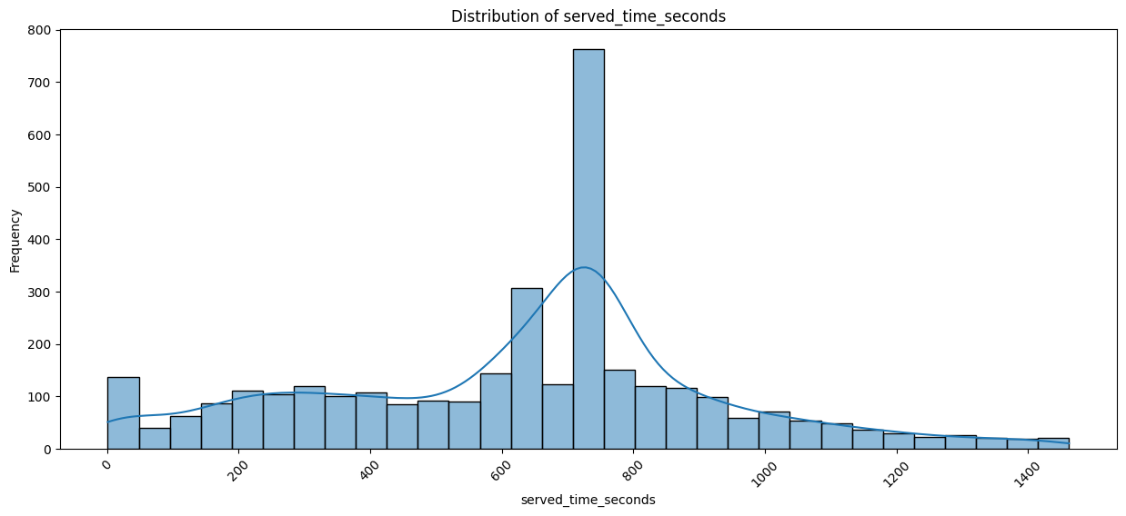
Visualizations

Slide 9
Explanation: Distribution of served time
The distribution of served time is right-skewed with a peak around 700 seconds.
There is a significant number of observations with served times in the range of 600 to 800 seconds.
There are fewer observations with very low (near 0) or very high (over 1000) served times with one expectation at 0-50.
The KDE line visualize overall shape of the distribution, confirming the concentration around the median and the presence of a long tail.

Slide 10
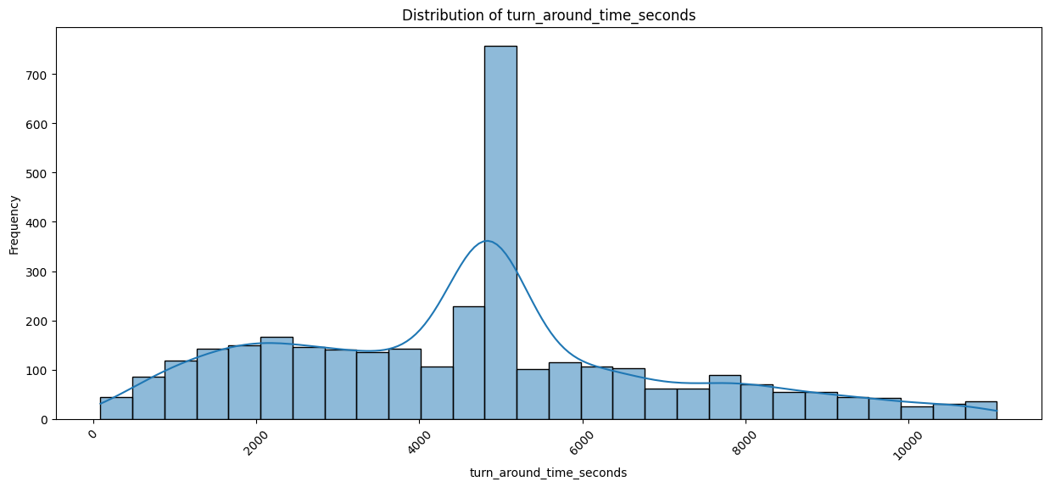
Visualizations

Slide 11
Explanation: Distribution of served time
The most common turnaround time is around 4000 seconds. Many processes complete around this peak time.
There are a significant number of instances where the turnaround time is both shorter and longer
The distribution is right-skewed, with a long tail indicating some processes take much longer and shorter time.

Slide 12
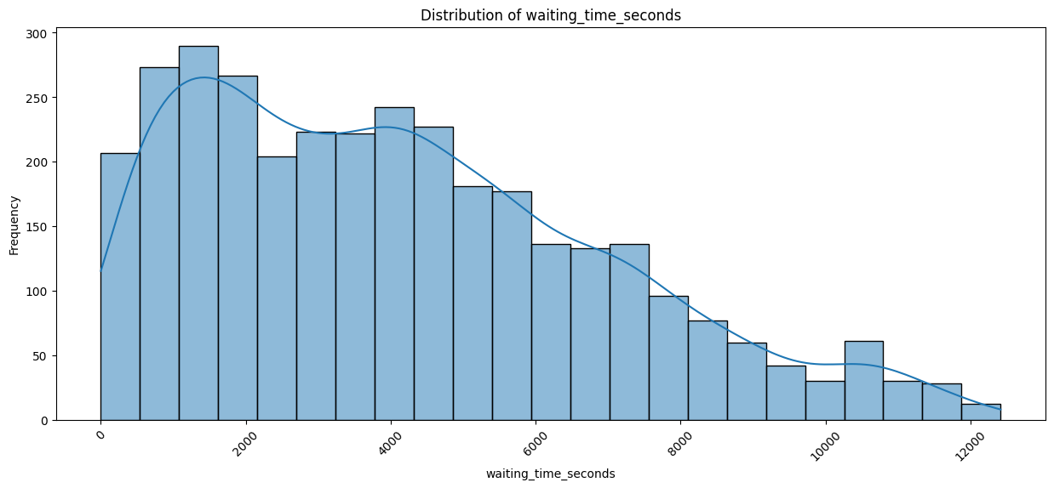
Visualizations

Slide 13
Explanation: Distribution of served time
The distribution starts with a rise in frequency, peaking around 1000 to 2000 seconds.
There are several peaks and valleys throughout the distribution, with frequencies gradually decreasing as waiting time increases.
The distribution is right-skewed, with a long tail extending towards higher waiting times.

Slide 14
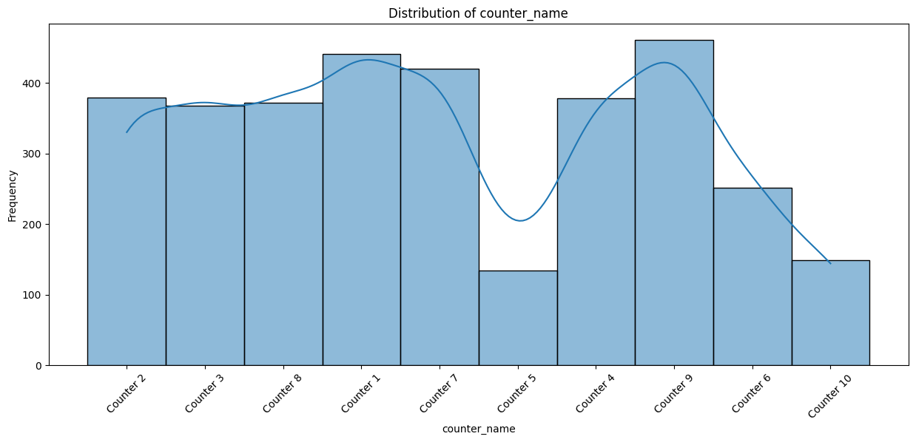
Visualizations

Slide 15
Explanation: Distribution of served time
There is a preference or higher usage for Counter 1 and Counter 9, suggesting these counters might be more accessible, more efficient, or preferred for other reasons.
Counter 5's low usage suggests it might be less accessible, less efficient, or avoided for some reason.
The varying usage of the counters indicates some form of imbalance or preference in how the counters are being utilized.

Slide 16
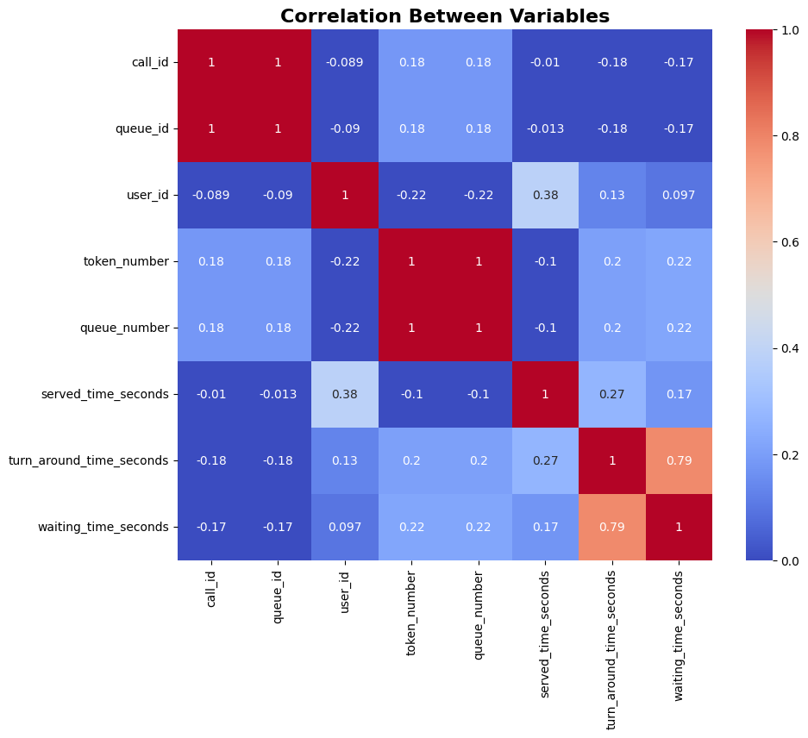
Heatmap of variables in dataset

Slide 17
Explanation of correlation
Strongest Positive Correlation:
turn_around_time_seconds and waiting_time_seconds have a high positive correlation of 0.79. This suggests that as the waiting time increases, the turnaround time also tends to increase.
user_id and served_time_seconds have a positive correlation of 0.38, indicating a moderate relationship between these variables.
Negative Correlations:
call_id and user_id have a negative correlation of -0.089.
call_id and turn_around_time_seconds have a negative correlation of -0.18.
Weak or No Correlation:
Many of the correlations are close to 0, indicating weak or no linear relationship between those pairs of variables.

Slide 18
Insights from correlation
Strong Correlation Between Turnaround Time and Waiting Time:
The high correlation (0.79) between turn_around_time_seconds and waiting_time_seconds indicates that as waiting times increase, turnaround times also increase. This suggests that reducing waiting times could significantly reduce overall turnaround times.
Moderate Correlation Between User ID and Served Time:
The moderate positive correlation (0.38) between user_id and served_time_seconds suggests that certain users (possibly specific types of services or counters) take longer to serve. Identifying these users or services could help in addressing bottlenecks.
Served Time Distribution:
The histogram of served times shows a peak around 600-700 seconds with a long tail. This indicates that while most services are handled within this timeframe, there are outliers that take significantly longer.

Slide 19
Recommendations
Optimize Counter Staffing During Peak Hours:
Analysis of Peak Hours: Perform a time-based analysis to identify peak hours with the highest turnaround and waiting times.
Dynamic Staffing: Implement dynamic staffing strategies where more counters or staff are allocated during peak hours to reduce waiting times and, consequently, turnaround times.
Investigate the performance counter 5 thoroughly and solve the problem son
Improve Service Efficiency for Specific Services:
Identify Bottlenecks: Use the user_id data to identify which services or counters have longer served times. Conduct a detailed process analysis for these services to identify inefficiencies.
Training and Resources: Provide additional training for staff handling these services and ensure they have all necessary resources to improve efficiency.
Implement Appointment or Queue Management Systems:
Reduce Waiting Time: Introduce an appointment system or an advanced queue management system to better manage customer flow and reduce waiting times. This can help in smoothing out the peaks and distributing the workload more evenly.
Real-Time Monitoring: Use real-time monitoring of queue lengths and waiting times to dynamically adjust staff allocation and open more counters as needed.

Slide 20
Recommendations
Analyze and Address Outliers in Served Times:
Case Studies: Conduct case studies on outliers with exceptionally long served times to understand the underlying causes (e.g., complex cases, insufficient information).
Process Improvements: Implement process improvements or additional support mechanisms for handling such outliers more efficiently.
Customer Feedback and Continuous Improvement:
Feedback Mechanism: Implement a customer feedback mechanism to gather insights directly from customers about their experiences and suggestions for improvement.
Continuous Improvement: Use this feedback, along with the data analysis, to continuously refine processes, train staff, and improve service delivery.

